Slide 1
I want to talk about 3 things and what Utah's officials can do about them:
COVID vaccine side effects, specifically myocarditis—it is serious, and it reveals incontrovertible malfeasance by federal health agencies against Utahns
The interference with patient autonomy and the doctor-patient relationship
Who has jurisdiction over healthcare? You do. You can prevent the healthcare problems that COVID exposed from being repeated.
Meryl Nass, M.D. (207) 522-5229

Slide 2
Myocarditis
Federal officials knew this was a COVID vaccine side effect by Feb. 2021 but hid this knowledge for months; here is a detailed timeline: https://www.theepochtimes.com/health/timeline-covid-19-vaccines-and-myocarditis-5317985
Only admitted it June 2021 after the vaccine was authorized for teens in May 2021
They still hide how often it occurs, failing to perform active surveillance, imaging or autopsy studies to learn frequency and severity of post-vaccine myocarditis
They hide that it is probably a common cause of sudden deaths in vaccinated young people, based on limited studies done privately
They fail to advise screening for myocarditis for athletes—those affected should not perform strenuous exercise until healed; this is basic medical care
They continue to push vaccine despite COVID now being mild in the vast majority

Slide 3
* The Israeli Ministry of Health contacted regulators in Europe and the US to share info about myocarditis cases from the Pfizer shots in 16 to 30 year olds on February 28, 2021. * FDA and CDC knew about this red flag yet authorized the vaccine for teens on May 10, 2021.
v

Slide 4
A Reuters report on myocarditis—then silence April 25, 2021

Slide 5
May 10, 2021 FDA Authorization for 12 thru 16 year olds

Slide 6
CDC finally admits the myocarditis risk is considerable in those under age 40 in June 2021, a month after authorizing it for teens

Slide 7
COVID vaccines are not the first to case myocarditis. Asymptomatic Myocarditis was discovered to be an adverse effect of smallpox vaccine in 1978 (1:34)
"Immunisation may induce myocardial complications. Serial pattern of ECG changes suggestive of myocarditis was recorded in eight of the 234 conscripts one to two weeks after vaccination against smallpox and diphtheria. Changes were mainly minor ST segment elevations and T wave inversions and usually they disappeared in a few weeks. The ECG positives more often had a history of atopy, and their mean body temperatures and heart rates after the vaccinations were higher than among the other subjects (p less than 0.01). However, clinical myocarditis was never noted, nor were immunological or enzymological changes different among the ECG positives. Thus in 3% of the study population, evidence of postvaccinal myocarditis was noted, based on serial ECG patterns, but without any other evidence of cardiac disease."
https://pubmed.ncbi.nlm.nih.gov/736507/

Slide 9
"The rate of myo/pericarditis reported in the civilian program after ACAM2000 smallpox vaccine (approximately 1:1,700 vaccinees)..." *600 cases per million doses ended the civilian vaccine program
Myo/pericarditis
In reports about the civilian program published previously, cases classified as myopericarditis included those occurring in persons reported to have chest pain and electrocardiogram (ECG) changes (e.g., ST-segment and T-wave abnormalities) within 30 days of vaccination without evidence of other causes (1--5). However, because myocarditis, which indicates inflammation of the myocardium and/or the myocardial conduction system, might manifest with dysrhythmias, the myo/pericarditis case definition now includes dysrhythmias as a clinical criterion
https://www.cdc.gov/mmwr/preview/mmwrhtml/mm5221a2.htm
May 30, 2003 MMWR

Slide 10
Notes:
Later CDC acknowledged that the risk of myocarditis from the ACAM2000 vaccine was nearly 6,000 cases per million doses. If the COVID vaccines cause myocarditis at the same rate, we could expect hundreds of thousands of cases in the US
This is a CDC slide used to brief an advisory committee meeting in summer 2022 regarding the two vaccines being rolled out for monkeypox. The ACAM 2000 vaccine caused myocarditis in 5.7 per thousand or 1 in 175 vaccine recipients who had not previously received smallpox vaccine. The COVID vaccines may cause myocarditis this frequently

Slide 11
Passive surveillance: > 1:2000

Slide 12
The doctor-patient relationship, patient autonomy and informed consent were kicked to the curb with COVID
The federal government became the doctor: it withheld certain drugs and enforced the use of others through financial incentives, threats, mandates and a campaign against "medical misinformation." Most states assisted the feds in this campaign.
Doctors became enforcement agents of the state, losing their primary allegiance to the patient
Emergency laws put in place at the state and federal level after the 2001 anthrax letters (the Model State Emergency Health Powers Act and federal laws such as the PREP Act) created the opportunity to use unlicensed, untested medical products on the whole population, with no liability for the manufacturer, the doctors or government officials
https://www.law.cornell.edu/uscode/text/42/247d-6d
https://law.asu.edu/sites/default/files/pdf/msehpa_-_final.pdf
Instead of informed consent, a fact sheet was provided that lacked the required 'significant' safety information, and a false vaccine license was issued by FDA to enable mandates while only offering unlicensed EUA vaccines, for which no one was liable.

Slide 13
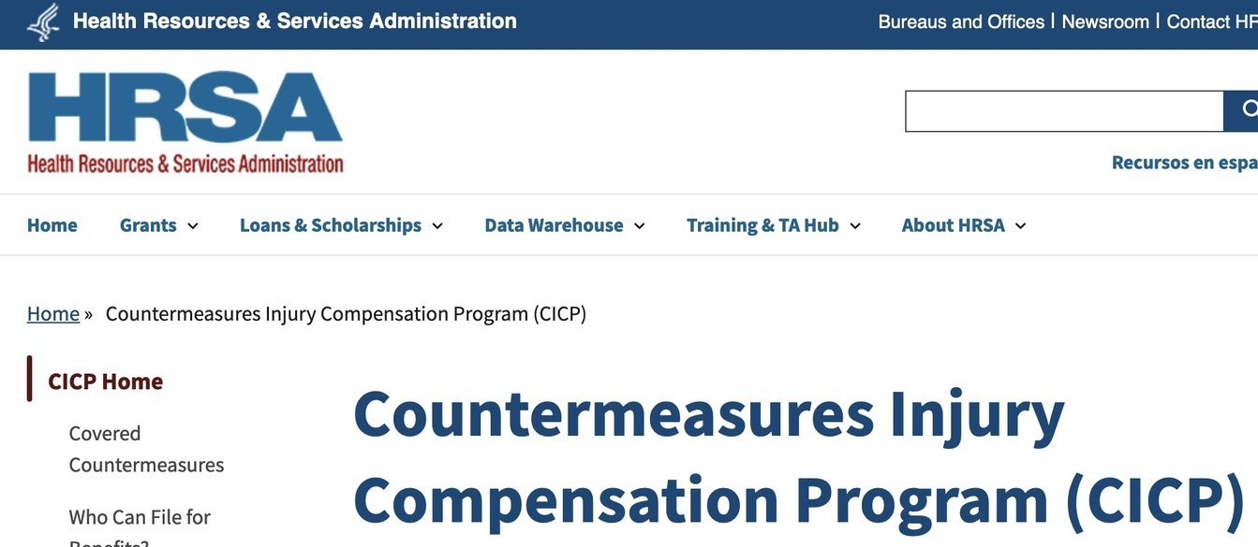
https://www.hrsa.gov/cicp/cicp-data
Notes:
And compensation averaged only about $2,000 per injury

Slide 14
x
Notes:
This program is one way the government enforced the use of dangerous remdesivir over other drugs—by giving a 20% bonus over the entire cost of hospitalization if the drug was used

Slide 15
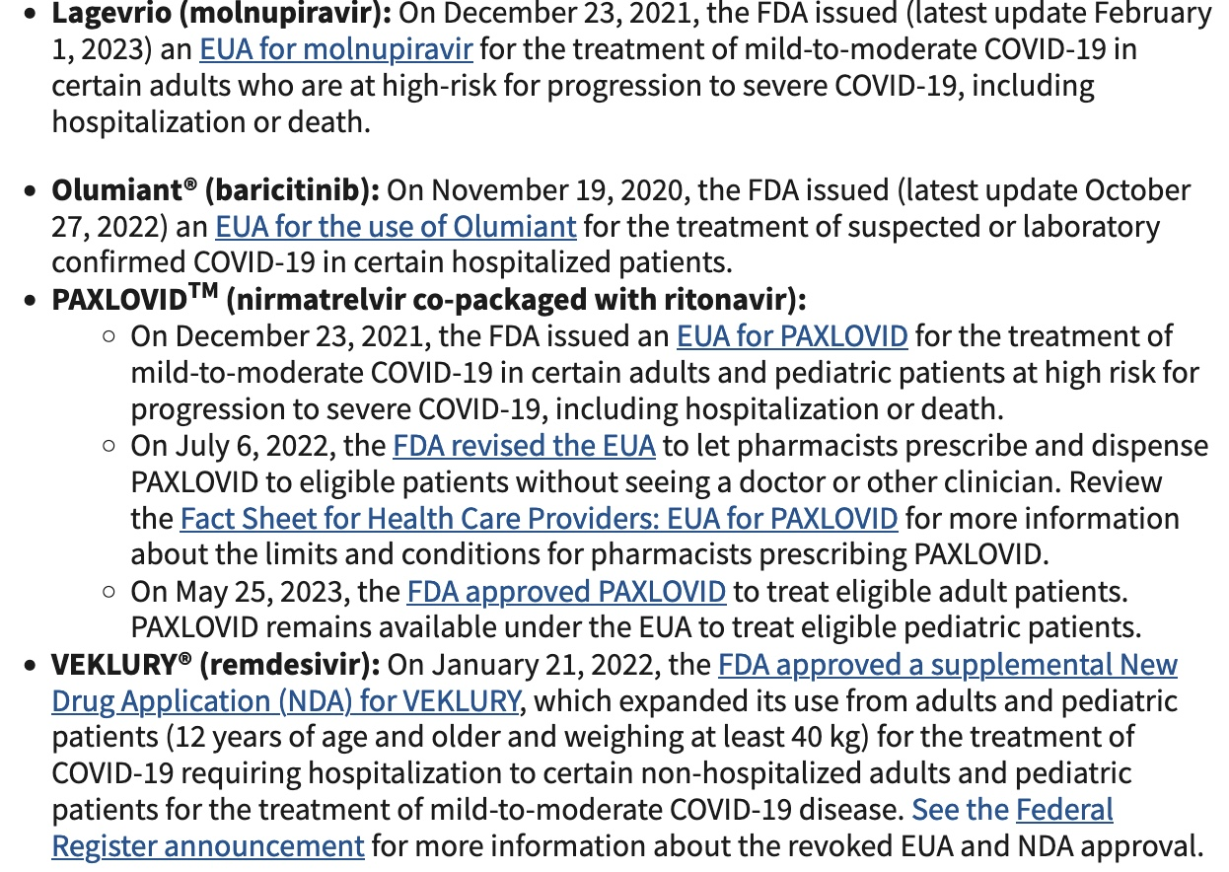
Medicare provided a 20% bonus payment of the entire hospital bill if specified drugs like remdesivir were used to treat COVID
8

Slide 16
Health insurers paid huge bonuses to doctors for getting hold-outs vaccinated
Bonuses ranged from a low of $20 extra per shot, if only 30% of a practice was vaccinated.
Doctors received up to a $250 bonus per shot, when 75% of a medical practice was vaccinated, and the vaccine recipient had not previously been vaccinated for COVID
This example is from Anthem in Kentucky, but similar programs existed in other states

Slide 17
The US Surgeon General, Dr. Vivek Murthy, issued a public health alert on misinformation!
Notes:
Even though it is protected first amendment speech

Slide 18
The accumulated data on ivermectin and hydroxychloroquine is highly positive
380 controlled trials on HCQ for COVID
95 controlled trials on ivermectin for COVID
No matter what parameters you look at, each drug had a positive effect on mortality, hospitalization, disease prevention, etc.
Both very safe at recommended doses
Each legally had to be suppressed in order for EUAs to be issued for other drugs and for the vaccines

Slide 19
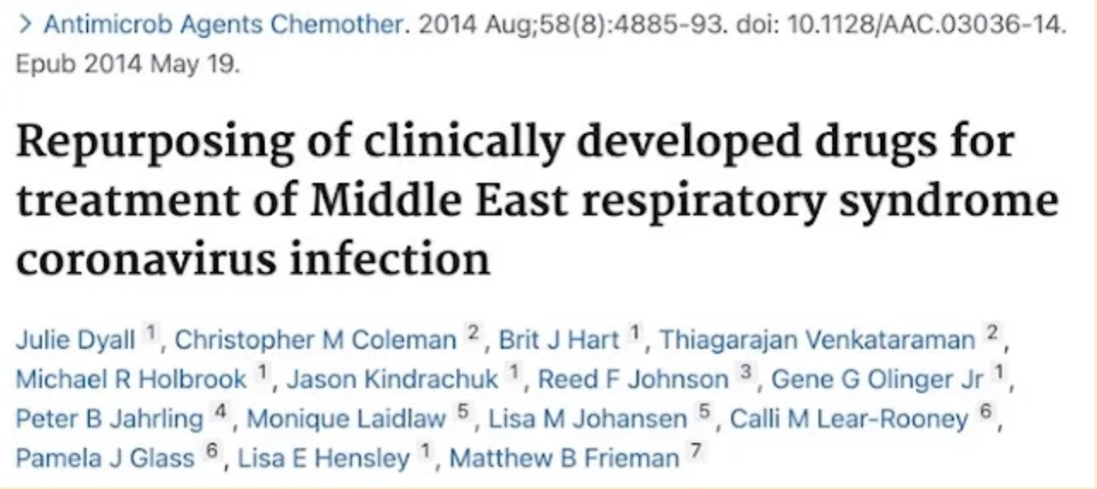
The CDC showed in 2005 that chloroquine killed SARS-1, and the NIAID showed in 2014 that 66 different repurposed drugs killed SARS and/or MERS
x

Slide 20
https://c19hcq.org/

Slide 21
https://c19ivm.org/

Slide 22
By Robert F. Kennedy Jr. Meryl Nass, M.D.
Monday, the U.S. Food and Drug Administration (FDA) approved a biologics license application for the Pfizer Comirnaty vaccine.
The press reported that vaccine mandates are now legal for military, healthcare workers, college students and employees in many industries. New York City Mayor Bill de Blasio has now required the vaccine for all teachers and school staff. The Pentagon is proceeding with its mandate for all military service members.
But there are several bizarre aspects to the FDA approval that will prove confusing to those not familiar with the pervasiveness of the FDA’s regulatory capture, or the depths of the agency’s cynicism.
First, the FDA acknowledges that while Pfizer has “insufficient stocks” of the newly licensed Comirnaty vaccine available, there is “a significant amount” of the Pfizer-BioNTech COVID vaccine — produced under Emergency Use Authorization (EUA) — still available for use.
The FDA decrees that the Pfizer-BioNTech vaccine under the EUA should remain unlicensed but can be used “interchangeably” (page 2, footnote 8) with the newly licensed Comirnaty product...
https://childrenshealthdefense.org/defender/mainstream-media-fda-approval-pfizer-vaccine/

Slide 23
Fauci explains to former DHHS Secretary Sylvia Burwell that masks don't work, in February 2020
Notes:
Just in case mask mandates are urged, I wanted you to have this emai from Fauci to his former boss

Slide 24
The WHO has proposed a new Pandemic Treaty and Amendments to the existing International Health Regulations to give it more authority over healthcare worldwide
The WHO bureaucracy could become your doctor instead of the federal bureaucracy
I have discussed some of the dreadful issues in the treaty here:
https://merylnass.substack.com/p/the-whos-proposed-treaty-will-increase
and here:
https://rumble.com/v3e6lsd-dr-meryl-nass-pandemic-treaty.html

Slide 26
W.H.O. does whose bidding?

Slide 27
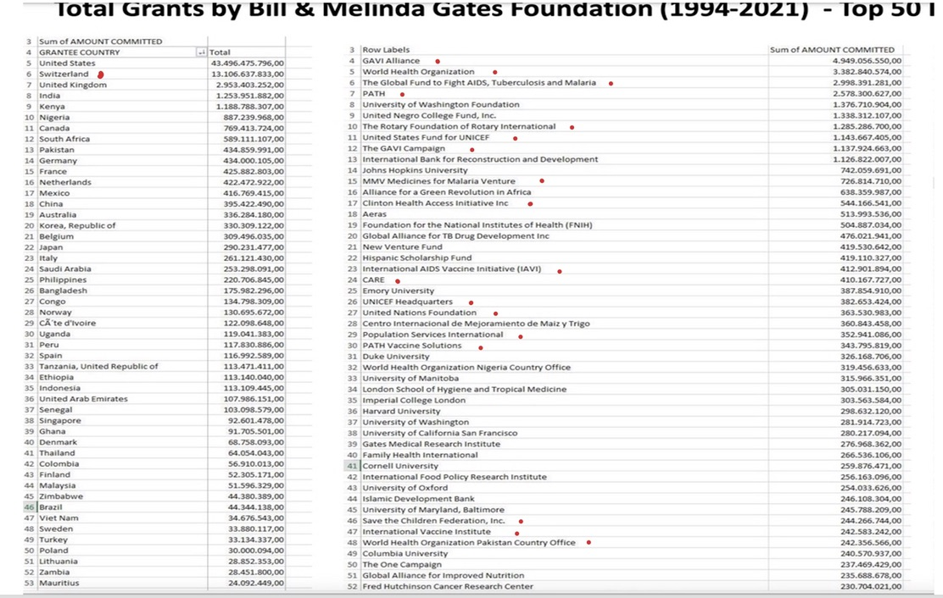

Slide 28
What can you do to stop federal and global overreach in the name of health from happening again?
1. Tenth Amendment: Governance of healthcare is left to the states. The state can send a message to the federal government that it alone has jurisdiction over the healthcare of its citizens, and this authority may not be turned over to the WHO or any other entity
2. HR79—Exit and defund the WHO, 52 cosponsors
3. HR 4665--Foreign operations bill, defunded WHO, WEF, John Kerry climate envoy etc., passed House last week (216-212)
4. Other bills pending in House and Senate that would require a Senate ratification of the WHO's pandemic treaty
5. Call to REVOKE the International Pandemic Preparedness Act embedded in the 2023 NDAA which commits the US to the global biosecurity agenda

Slide 29
And at the state, county and local level...
Revoke the state emergency laws that gave governors dictatorial powers
Protect doctors via an AG opinion, Governor, Board of Health, state Surgeon General or Legislature regarding freedom of doctors and patients to prescribe and access drugs they choose, to write vaccine waivers without government interference or license threats, be protected from "misinformation" charges, enshrine bodily autonomy and informed consent in law, etc. (2021 Nebraska resolution on IVM and HCQ is an excellent example). https://ago.nebraska.gov/sites/ago.nebraska.gov/files/docs/opinions/21-017_0.pdf
Ban GOF (biowarfare) research as proposed by legislators in Wisconsin
Pass laws, ordinances or resolutions regarding mandates, masks, vaccines, the WHO, other threats to freedom and sovereignty—make your choices known locally too (Collier County, FL, other FL counties, and Huntington Beach, CA) https://www.naplesnews.com/story/news/2023/04/12/health-freedom-ordinance-gets-unanimous-approval-in-collier-county/70098846007/
Candidates for sheriff should be pushed to campaign on where they stand on protecting our freedoms
LEARN about the WHO power grab, biological warfare, unregulated EUAs

