Slide 1
A World Coup is proceeding quickly with the help of the W.H.O. and One Health
What are they doing, and how can we stop them?
Meryl Nass, MD 7/8/23
Why am I the messenger?
Reading their docs for 35 yrs
Discovered BW in Rhodesia
Decoding their language

Slide 2
Notes:
Our friends and relatives who cannot imagine that such a thing could be happening—and the cognitive dissonance of being unable to make sense of what they experience scrambles their brains

Slide 3
Just in case you thought we were out of trouble-- from the Telegraph

Slide 4
The New World Dis-Order, brought to you by a globalist cabal to confuse, destroy, control and "Build Back Better"
Gender confusion
Transhumanism, brain chips
Surveillance, electronic
Surveillance (swabs) for asymptomatic infection
Climate terrorizing
Food system attacks
Pollution of water, air, food, and our minds
Moral, ethical and legal confusion
Inflation, crashing economy
CBDCs—no more cash
Notes:
It clearly is not over. Our institutions, way of life and family relations are all under deliberate attack – carefully planned to separate us from each other and create insecurity, dissension and hate

Slide 5
I am going deep into the weeds with this talk about the global coup. I am sharing the slides so you can look at them later, or ideally look up some of the references and verify my take on this material.
Here is what this talk is about:
The global biosecurity agenda
The proposed amendments to the WHO's International Health Regulations (of 2005)
The WHO's proposed Pandemic Treaty (which has been given many different names)
"One Health" – a Trojan Horse
The UN's proposed 'Emergency Platform' https://www.un.org/sites/un2.un.org/files/our-common-agenda-policy-brief-emergency-platform-en.pdf
Federal laws and bills that help the coup (2023 NDAA) and stop the coup
What can be done at the federal, state and county level?

Slide 6
The WHO is being used for a soft coup via amendments to its International Health Regulations and a Pandemic Treaty
Removes language from current IHRs: "The implementation of these Regulations shall be with full respect for the dignity, human rights and fundamental freedoms of persons,"
Binding, enforceable, no longer recommendations—Requires only a declaration of a PHEIC
Enforced dual Surveillance
Enforced censorship
Reduced regulation of vaccines and drugs: quicker to market
Liability shield for drugs/vaccines; protection of intellectual property
"...Such temporary recommendations may be modified or extended as appropriate, including after it has been determined that a public health emergency of international concern has ended” -- before, during and after a potential emergency
One Health: a bogus concept by which WHO gains jurisdiction over the whole world
WHO budget would jump from <$4 billion/year to an estimated $60 billion/year or ?

Slide 7
But the concept of Pandemic Preparedness is a Myth
The last 2 pandemics declared by the WHO, SARS-2 and Monkeypox, were both for viruses made in labs.
US: $10 Billion/yr for the biodefense industry and when the pandemic hit we lacked everything, including gloves, masks, gowns, drugs, alcohol hand rubs—only the biodefense industry benefitted from biodefense spending
The W.H.O., a House Dem. Report of 12/22, the G20, the E.U. and the Global Preparedness Monitoring Board all demand the same things: more surveillance, more $ and One Health
My article on PP: https://merylnass.substack.com/p/the-myth-of-pandemic-preparedness-8e1
Dr. David Bell's article on PP: https://brownstone.org/articles/a-primer-on-the-who-the-treaty-and-its-plans-for-pandemic-preparedness/. PANDA: https://www.pandata.org/who-paradox/
Notes:
"As a ‘pandemic’ in WHO parlance does not include a requirement of severity but simply broad spread – a property common to respiratory viruses – this leaves a lot of room for the DG to proclaim emergencies"

Slide 8
Notes:
Every country was supposed to prepare, there were many different things they were asked to do. And countries received a grade for how well they were prepared. Whether they were 'up to speed' or not

Slide 9
Notes:
Government policies led to huge economic losses during the pandemic. Then the government uses those huge loses to justify more spending on pandemic preparedness, detection and so-called prevention.
Furthermore, by researching every viral family that infects humans, you would multiply the chances of a dangerous lab leak

Slide 10
'Preparedness' is very risky!
CDC and USDA run a Select Agent program for selected US Potential Pandemic Pathogens
There are 200 accidents per year reported to CDC re: select agents
In 2018 alone, 173 (of 201 reported) releases led to "895 individuals [receiving] occupational health services, including medical assessments and, if needed, diagnostic testing and prophylaxis."
https://web.archive.org/web/20200410035210/https://www.selectagents.gov/resources/FSAP_Annual_Report_2018_508.pdf
Notes:
potential pandemic pathogens

Slide 12
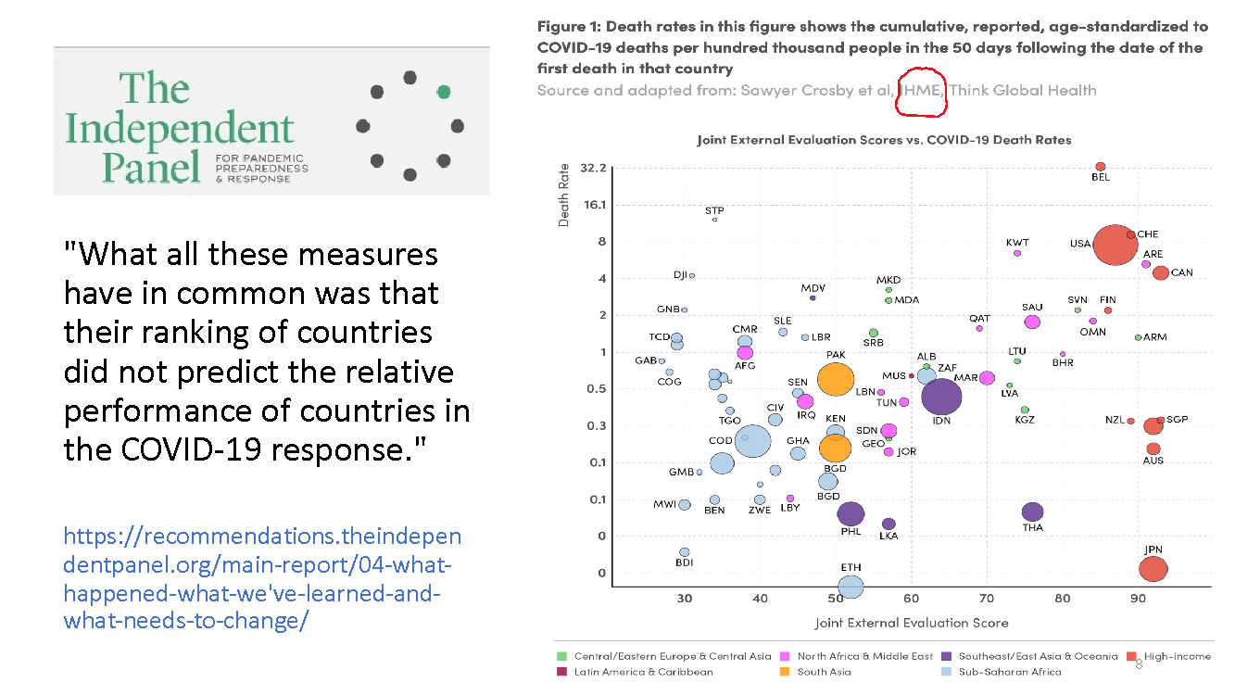

Slide 16
The Next 8 slides are all excerpted from a report on the European Union's Global Health Strategy, published in March 2023
It reveals how Europe will focus on health: More $ and power for the WHO, One Health, emergency preparedness and vaccines for every conceivable condition, not only infections, to be administered to all, especially Africa, under the guise of equity. All the text on these 8 slides quotes the report.

Slide 17
"As we shift the focus on what to do, an equally fundamental shift must occur on how to do it. A new global health order is emerging —and the EU must contribute to shaping it through a more strategic and effective engagement."
"Global governance will require a new focus to maintain a strong and responsive multilateral system, with a World Health Organization (WHO) at its core which is as sustainably financed as it is accountable and effective. Consensus should be built through deepened cooperation through G7, G20, and other global, regional and bilateral partners. The EU should drive the essential process of filling the existing gaps in global governance, avoiding duplication and ensuring coherence of action. This will need close cooperation with the private sector, philanthropic organisations, civil society and other stakeholders to support this strategy’s objectives."
https://health.ec.europa.eu/system/files/2023-03/international_ghs-report-2022_en.pdf

Slide 18
In the EU, universal health coverage and a strong EU health security framework will continue to be developed by taking forward key initiatives underway or under preparation. These include the Europe’s Beating Cancer Plan1, the Pharmaceutical Strategy, and the planned European Health Data Space.
Combatting health threats more comprehensively will be possible with the implementation of the new cross-border health threats regulation, the reinforced mandates of the European Center for Disease Prevention and Control and the European Medicines Agency, the work of the new Health Emergency Preparedness and Response Authority to improve preparedness and response in medical countermeasures, and a One Health network to act against all pathogenic threats with integrated surveillance.
https://health.ec.europa.eu/system/files/2023-03/international_ghs-report-2022_en.pdf

Slide 19
Vaccines must be developed and used on children and adults, especially in Africa

Slide 20
Spinning the Daszak/Fauci false argument that pandemics are due to climate change and interactions with wild animals, rather than coming from labs and gov't paid scientists—and will be frequent

Slide 23
Making everything else part of 'health' enables governing bodies to control other sectors in the name of health

Slide 25
Why is this being imposed on Europe first?
The existence of the European Union already impinged on national sovereignty
Healthcare is regulated by the states according to the Constitution, not by the federal government in the US
Most of western Europe does not allow citizens to have guns
Western Europeans trusted their governments more during the plandemic than Americans did
The US has lower reported COVID vaccination rates than all of western Europe

Slide 27
What is One Health?
"One Health is an integrated, unifying approach that aims to sustainably balance and optimize the health of people, animals and ecosystems. It recognizes the health of humans, domestic and wild animals, plants, and the wider environment (including ecosystems) are closely linked and inter-dependent.
The approach mobilizes multiple sectors, disciplines and communities at varying levels of society to work together to foster well-being and tackle threats to health and ecosystems, while addressing the collective need for clean water, energy and air, safe and nutritious food, taking action on climate changes and contributing to sustainable development."
https://www.onehealthcommission.org/en/why_one_health/what_is_one_health/
The One Health High Level Expert Panel created this definition.
Notes:
It is not a THING, but instead an approach?
It has no solid meaning. It basically used wordsmithing to claim that everything on the planet is interrelated and affects health. The One Health Approach is vague, and its proponents have great difficulty pointing to anything that has benefited from applying the OH approach. There is no there there.
The use of language gives it away—certain phrases repeat. There is no specificity about what it is that is being discussed. The meaning of sentences is obscure. Yet there is uniformity of nebulousness in all the One health definitions and documents written by different groups.
This is a tale of false narratives—and a lesson about how discerning we need to be now that we live in a world of lies.

Slide 28
The Lancet One Health Commission
"The ambition of The Lancet One Health Commission is to generate insight into the interconnected nature of health among humans, animals, plants, and the wider environment, and to galvanize transformations in global governance, economics, and knowledge to ensure equitable, sustainable, and healthy socioecological systems in the 21st century and beyond."
https://www.med.uio.no/helsam/english/research/centres/global-health/networks/one-health-networks/
Notes:
https://www.med.uio.no/helsam/english/research/centres/global-health/networks/one-health-networks/

Slide 29
Notes:
38 words in first sentence, 51 in second sentence. neither sentence has actual meaning, and they were written simply to confuse the reader. It is unnerving to realize that there are people whose job it is to write this drivel. We have to maintain our compassion for them too. They probably have families and a mortgage, and they grew up in a society that had lost its way regarding morals and ethics.

Slide 37
The 2023 National Defense Authorization Act (NDAA (passed Dec 2022) has enshrined in US law a commitment to follow the WHO and use the One Health approach
Subtitle D—International Pandemic Preparedness (pages 950-967)
We will comply with the global health security agenda
We will advance the One Health approach
We will fund Gavi, A Bill Gates vaccine NGO
We will be part of an early warning network—though none have ever worked
We have the right to send personnel into a hostile country if it refuses to share information about an outbreak—to do what?
At least $1 billion a year is allotted for this purpose
Proliferation issues that other treaties prevent are ignored
Ways to measure 'progress' in readiness are useless

Slide 38
We need to call this what it is. The W.H.O.'s proposed IHR amendments and pandemic treaty, "One Health," and the UN Emergency Platform are merely complicated legal mechanisms to obtain jurisdiction over the world under the guise of an emergency
The American people do not want the WHO to have the power to impose lockdowns, masks, quarantines, vaccine mandates or anything else
This power grab is being negotiated in secret and will be voted on in May 2023 for the WHO
The best way to prevent the WHO from gaining sovereignty over nations is to Exit and defund the WHO

Slide 39
But Great Things are Happening!
Collier County, FL resolution—very broad
States and counties and cities can declare they will not allow the WHO to take over their sovereignty. Health care is reserved for the states according to the Constitution
NH is a very important state because of its role in the Presidential election—candidates can be forced to state their position when they come to campaign. Stumping in NH gets publicity
NH has the only majority Republican legislature in New England (though all 4 federal reps are Democrats)

Slide 40
The Republican party of a state can call on federal elected officials to exit the WHO
New Hampshire could do this—it would take a lot of phone calls and letters and meetings with party members and representatives at all levels—but you are a dedicated group who could accomplish this.
All our victories have been the result of this grass roots movement, of people like us who said things have gone too far and are willing to make a fuss! This passed in May.

Slide 41
More Great Things!
MO v. Biden: preliminary injunction July 4, Judge Terry Doughty of LA
House bill HR 79 to exit and defund the WHO – 49 cosponsors
Senate bill to require the pandemic treaty to be approved by the Senate – 47 cosponsors. House bill does the same thing.
The State Department Foreign Operations budget draft has funding for the WHO struck out

Slide 42
Here are 3 bills that have been proposed calling for the U.S. to stop funding the WHO or demand a Senate vote on the Pandemic Treaty:
H.R.343 (No Taxpayer Funding for the World Health Organization Act),
H.R.1425 (No WHO Pandemic Preparedness Treaty Without Senate Approval Act) and
S.444 (No WHO Pandemic Preparedness Treaty Without Senate Approval Act).

Slide 43
What can you do?
Talk to everyone you know about this—we are being censored so you have to spread the word one person at a time
Talk to your elected representatives, who are mostly ignorant about this issue.
We need to get Dems up to speed to start signing on to the bills just discussed
We need resolutions at the state and county level, which wakes people up
Follow the issue at the SovereigntyCoalition.org
Follow James Roguski on Substack—JamesRoguski.substack.com
Follow me—MerylNass.substack.com
Notes:
What do you like to do? What are you good at?

Slide 44
Coming very soon: DoortoFreedom.org
A One Stop Shop to find everything you need about the WHO power grab and other globalist sovereignty grabs
2 minute reads on: the WHO documents, climate change, transhumanism, CBDCs, vaccine passports, misinformation, ESG standards, One Health, the World Economic Forum, the WEF's Young Global Leaders, Medical Ethics
Longer curated articles for more depth
Copies of the proposed Int'l Health Reg. amendments, Pandemic Treaty, NDAA, UN documents, etc.
We hope your organization will join us for coordinated actions–-coming next

